Slide 1
IBAMR Finite Element Visualization with VisIt

Slide 2
Please also see the youtube tutorial from Shannon Jones here:
https://www.youtube.com/watch?v=Kj_MACemSd0

Slide 3
File Formats
dumps.visit – Eulerian data
output.ex2 – Finite Element/Lagrangian data
Exodus II type file
Can have multiple files of this type for different parts of object

Slide 4
Open dump.visit and output.ex2 in VisIt
In the left hand corner, unclick the “Apply operators to all plots” option
Under active source, choose the output.ex2
Load mesh (but don’t Draw)

Slide 5
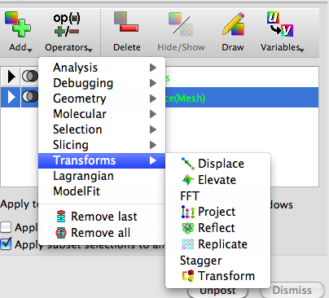

Load mesh (but don’t Draw)
Highlight the mesh and go to Operators>Transforms>Displace
Collapse the Mesh option and double-click on the Displace option

Slide 6
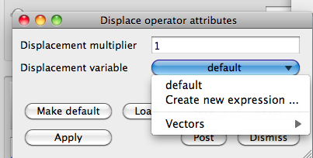
Under the options for the ‘Displacement variable’, go to ‘Create New Expression’
In the new window, change the Type to ‘Vector Mesh Variable’ (and also change the name of the new variable to ‘dX’)

Slide 7
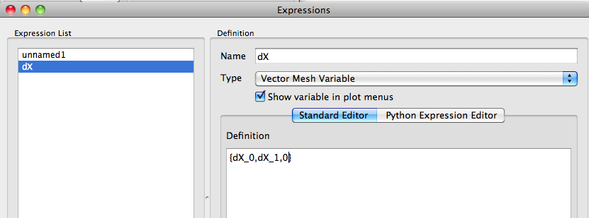
In the ‘Definition’ section, write ‘{dX_0,dX_1,0}’ if 2D and ‘{dX_0,dX_1,dX_2}’ if 3D.
Note: For new ibamr install in 2D, use {dX_0,dX_1}
At this point I would save this variable as an XML file because you will need to do this every time. Hit ‘Apply’ on the ‘Expressions’ window and close it.

Slide 8
Now change the Displacement variable option to Vectors>dX. Hit Apply and close the menu. This allows changes from the reference configuration.
Add whatever other variable you want (for instance Omega)
You may not need to do the steps below with new ibamr module (if you displace using {dX_0, dX_1}).
Remember, the Finite Element mesh is in 3D and the Eulerian variables are all in 2D so we will need to project the mesh to 2D.
Highlight the mesh and click Operators>Transforms>Project
The default projections should be for the xy-plane(which is what we want), but you can change this if you want if you double click Project in the collapsed menu from the Mesh Object.
Draw!

Slide 9
Examples List
ex0: Rubber band
ex1: Stretched rubber band
ex2: Cavity flow with mesh at bottom
ex3: Cavity flow with mesh at bottom
ex4: Cavity flow with deformable ball
ex5: Flow past cylinder
ex6: Flow past beam and block (square with long rectangular tail)

